Slide 1


Microsoft Azure Well-Architected Framework pillar
-Cost Optimization
By: Asmit Patel

Slide 2


Overview
CostOptimization
01
Why Cost Optimization
02
Ways to Optimize Costs
03
Conclusion
04

Slide 3
What is Cost Optimization
Cost Optimization focuses on delivering business value while avoiding unnecessary expenses. In the context of Azure, this means efficiently managing cloud resources to minimize costs while ensuring that the architecture meets performance, reliability, and security requirements.

Slide 4
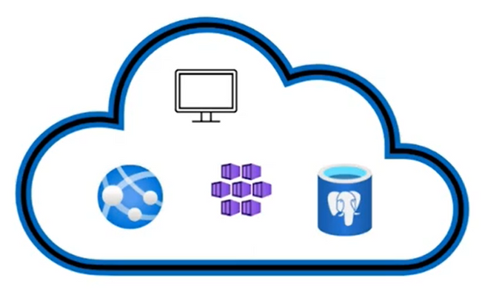
Why Cost Optimization ?
Cost optimization is a crucial aspect of cloud computing, including Microsoft Azure, for several reasons:
Avoid unnecessary expenses: Cloud resources can be easily provisioned, but if not managed properly, can lead to wasted resources and unnecessary costs.
Right-size resources: Ensure that resources match workload requirements, avoiding over-provisioning and under-provisioning.
Improve budgeting and forecasting: Accurately predict and manage costs to ensure alignment with business objectives.
Maximize ROI: Optimize costs to achieve a higher return on investment (ROI) from Azure workloads and application

Slide 5
Ways to Oprimize the Investment of Cloud with Cost Management
Plan Ahead- Planning ahead involves forecasting and preparing for future cloud resource needs and costs to avoid overspending and ensure efficient use of resources.
Ensure Visibility-Ensuring visibility means having clear insights into how cloud resources are being used and how costs are being incurred. This is essential for effective cost management and optimization.
Be accountable-Being accountable involves ensuring that cloud spending is managed responsibly and aligns with organizational goals. Accountability helps in controlling costs and maintaining financial discipline.
Optimize-Optimizing involves continually assessing and adjusting cloud resource usage and costs to achieve the best value.

Slide 6
CONCLUSION
The Cost Optimization pillar of the Azure Well-Architected Framework is essential for ensuring that cloud resources are used efficiently and effectively, without unnecessary waste or expense. By implementing cost optimization strategies, organizations can:
Reduce costs and improve ROI
Align resources with business objectives
Enhance budgeting and forecasting
Improve business agility and competitiveness
Maximize the value of Azure investments

